Slide 1
Forest Cover type Classification
Data Set: https://archive.ics.uci.edu/ml/datasets/Covertype
University of California, Irvine
Center for Machine Learning and Intelligent Systems
Python, sklearn, matplotlib, Tensorflow, Keras

Slide 2
Abstract
This study is aimed at researching various machine learning techniques to predict the forest cover type on the dataset provided by Remote Sensing and GIS Program, Colorado State University. The algorithms have been chosen based on researching previous work on the same dataset and the academic knowledge acquired. Random forest & Extra trees were seen as overall best in terms of both accuracy and speed.

Slide 3
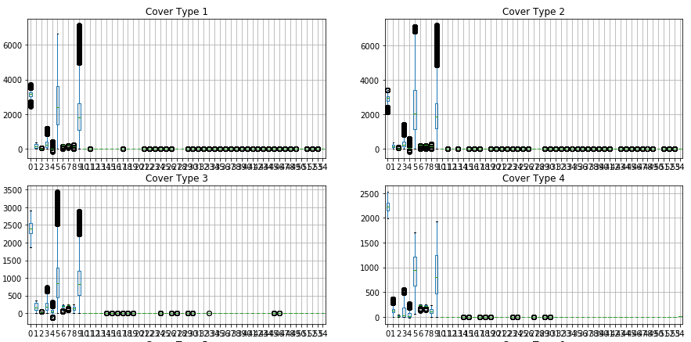
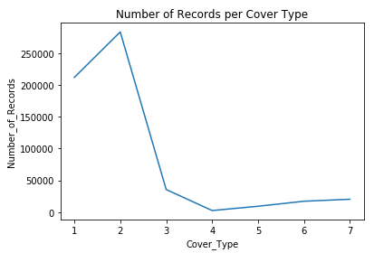
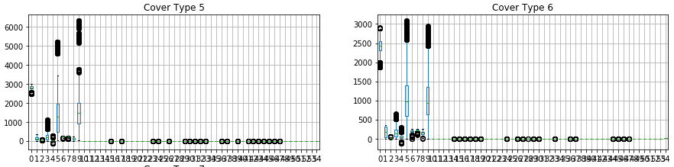
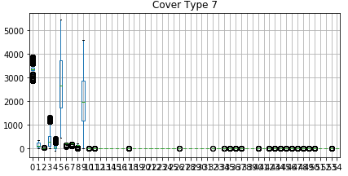
Exploratory Analysis – Box plots and scatter plots

Slide 4
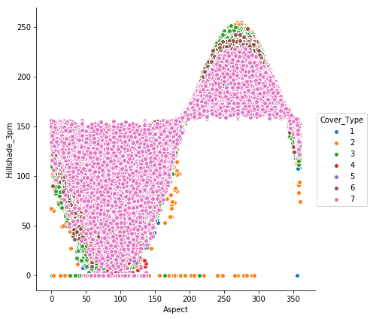
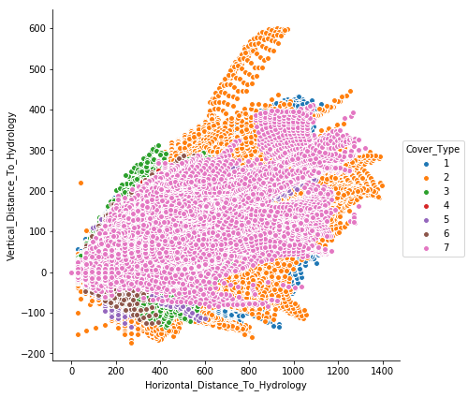
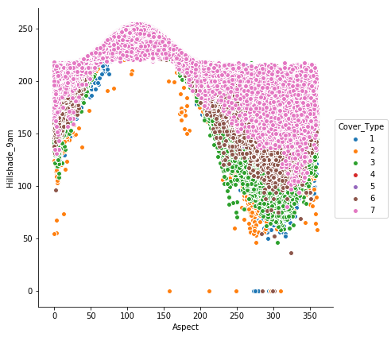
Exploratory Analysis - Box plots and scatter plots
The following can be inferred from the diagrams :
Significant number of outliers were observed in cover type (1,2,3,5,6)
Most of data variance were encountered in top 11 features.
For CoverType 3,4, the data distribution is limited to fewer features.
Correlation between Aspect and Hillshades attributes shows a sigmoid pattern.
Horizontal distance to hydrology and vertical distance to hydrology gives a linear pattern.

Slide 5
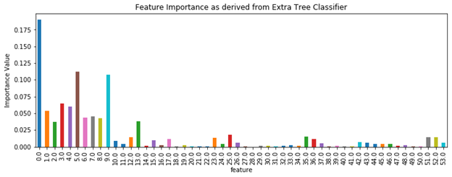
Feature Engineering
Feature Scaling
Dimensionality Reduction
PCA
Feature Importance based reduction
Reverse ‘One-Hot Encoding’

Slide 6
ML Algorithms Implemented
Random Forest
Extremely Randomized tree Classifier
Support Vector Machine - Multi-Class
Neural Network
Logistic Regression
Naive Bayes

Slide 7
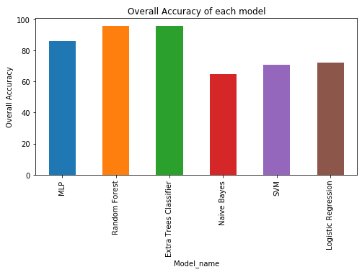
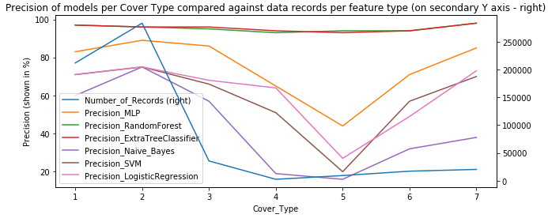
Model Comparison

Slide 8
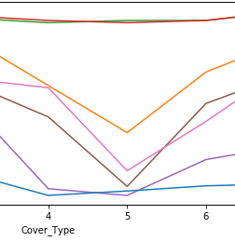
Interesting Observation about models performance
There is an interesting observation about models performance for cover type 4 & 5
The no of records for Cover type 4 = 2747
The no of records for Cover type 5 = 9493
For all other cover types, the number of records is way above (at least >10k)
But we observe an unusual dip in Models performance for Cover type 5
Apart from Random Forest & Extra random trees all other models give least precision for cover type 5 whereas their performance is much better for cover type 4 which has least number of records.
So, we observe data of cover type 4 & 5 in more depth

Slide 9
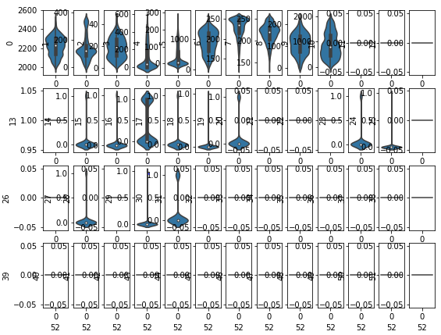
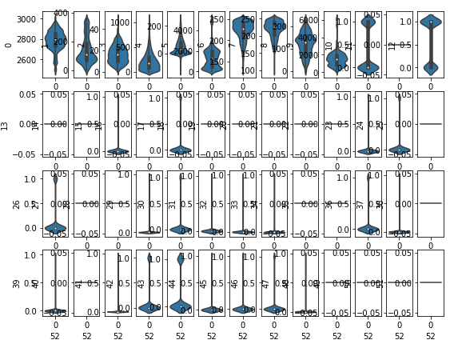
Violin Plots for Cover Type 4&5
we can draw following conclusions for a multilabel dataset based on our observation:
If the number of data records (for a given label) are high the learning models can better handle the scattering and outliers and still give good performance.
If the number of data records (for a given label) are low the learning models give low performance if the data has high variance and spread across features.

